Slide 1

Azure webinar series
Cluster Management
- Security
Notes:
Replace cover image: go to Format Background > Picture or texture file
Adjust gradient: go to View > Slide Master > Adjust shape fill options

Slide 2
Welcome

Slide 3

Meet our speaker
Mohammad Nofal
Cloud Native Compute Architect – Global Black Belt Team – EMEA
@mohmd_nofal
Notes:
Speaker image: Insert/Paste image > Picture Format > Crop > Aspect Ratio 1:1 > Crop > Crop to shape (circle) > Resize to template

Slide 4
Contents
Security
Cluster Security
Image Security
Containers Security
Demo
Notes:
test

Slide 5
Security

Slide 6



Security overview
Cluster and Node level security
Authentication and Authorization using AAD and RBAC
Automatic security patching nightly
Nodes deployed in private virtual network subnet w/o public addresses
K8s Dashboard Security
Egress and Ingress Traffic
Internal User
External User
Azure Container Registry
App Gateway
Developer
AKS with RBAC
2
Image and container level security
AAD authenticated Container registry access
ACR image scanning and content trust for image validation
Internal Load Balancer
External Load Balancer
1
Azure VNet
Active Directory
Ingress Controller
Ingress Controller
External DNS
3. Workload level security
Secure access to resources & services (e.g. Azure Key Vault) via Pod Identity
Storage Encryption
App Gateway with WAF to protect against threats and intrusions
Network policy to secure communication paths between namespaces (and nodes)
Security Context, Pod Security Policies, and Open Policy Agent
Node
Node
Pod
Pod
3
AAD Pod Identity

Slide 7
Cluster Security

Slide 8

Cluster Level – Kubernetes RBAC and Azure AD integration
Kubernetes Developer authenticates with AAD
The AAD token issuance endpoint issues the access token
Azure Active Directory
Developer performs action w/ AAD token. Eg. kubectl create pod
1
4
<\>
Token
2
Kubernetes validates token with AAD and fetches the Developer’s AAD Groups Eg. Dev Team A, App Group B
Developer
3
AKS
5
Kubernetes RBAC and cluster policies are applied
6
Request is successful or not based on the previous validation
Notes:
Admins Access

Slide 9

Cluster Level – Kubernetes RBAC and Azure
RBAC Roles
Kubernetes Administrator
Kubernetes Administrator authenticates with AAD
1
The AAD token issuance endpoint issues the access token
Azure Active Directory
Token
2
Administrator fetches the admin kubeconfig and configures RBAC roles and bindings
3
<\>
Token
Kubernetes Developer fetches the user kubeconfig
Developer
AKS
4

Slide 10
Provisioning AD-enabled AKS
$ az aks create --resource-group myAKSCluster --name myAKSCluster --generate-ssh-keys \
--aad-server-app-id <Azure AD Server App ID> \
--aad-server-app-secret <Azure AD Server App Secret> \
--aad-client-app-id <Azure AD Client App ID> \
--aad-tenant-id <Azure AD Tenant>
$ az aks get-credentials --resource-group myAKSCluster –name myAKSCluster --admin
Merged "myCluster" as current context ..
$ kubectl get nodes
NAME STATUS ROLES AGE VERSION
aks-nodepool1-42032720-0 Ready agent 1h v1.9.6
aks-nodepool1-42032720-1 Ready agent 1h v1.9.6
aks-nodepool1-42032720-2 Ready agent 1h v1.9.6

Slide 11
Provisioning AD-enabled AKS
Setting up a Cluster Role
Bind the Cluster Role to a user
apiVersion: rbac.authorization.k8s.io/v1beta1
kind: ClusterRole
metadata:
labels:
kubernetes.io/cluster-service: "true"
name: cluster-admin
rules:
- apiGroups:
- extensions
- apps
resources:
- deployments
verbs:
- get
- list
- watch
- update
- patch
- apiGroups:
- ""
resources:
- events
- namespaces
- nodes
- pods
verbs:
- get
- list
- watch
apiVersion: rbac.authorization.k8s.io/v1
kind: ClusterRoleBinding
metadata:
name: contoso-cluster-admins
roleRef:
apiGroup: rbac.authorization.k8s.io
kind: ClusterRole
name: cluster-admin
subjects:
- apiGroup: rbac.authorization.k8s.io
kind: User
name: "user@contoso.com"
Bind the Cluster Role to a group
apiVersion: rbac.authorization.k8s.io/v1
kind: ClusterRoleBinding
metadata:
name: contoso-cluster-admins
roleRef:
apiGroup: rbac.authorization.k8s.io
kind: ClusterRole
name: cluster-admin
subjects:
- apiGroup: rbac.authorization.k8s.io
kind: Group
name: "894656e1-39f8-4bfe-b16a-510f61af6f41"

Slide 12
Provisioning AD-enabled AKS
$ az aks get-credentials --resource-group myAKSCluster --name myAKSCluster
$ kubectl get nodes
To sign in, use a web browser to open the page https://microsoft.com/devicelogin and enter the code BUJHWDGNL to authenticate.
NAME STATUS ROLES AGE VERSION
aks-nodepool1-42032720-0 Ready agent 1h v1.9.6
aks-nodepool1-42032720-1 Ready agent 1h v1.9.6
aks-nodepool1-42032720-2 Ready agent 1h v1.9.6
Or
Error from server (Forbidden): nodes is forbidden: User baduser@contoso.com cannot list nodes at the cluster scope

Slide 13
AKS and Service Principals
Cluster Service Principal
To allow an AKS cluster to interact with other Azure resources, an Azure Active Directory service principal is used.
AD Integration Objects
When configuring Azure AD for AKS authentication, 2 Azure AD application are configured.
Server Application - used to get a users Azure AD group membership
Client Application - used when logging in with the Kubernetes CLI (kubectl
You can Rotate/Update them with:
$ az aks update-credentials --resource-group myResourceGroup --name myAKSCluster --reset-service-principal --service-principal $SP_ID --client-secret $SP_SECRET

Slide 14
Cluster Security
Audit Logs

Slide 15
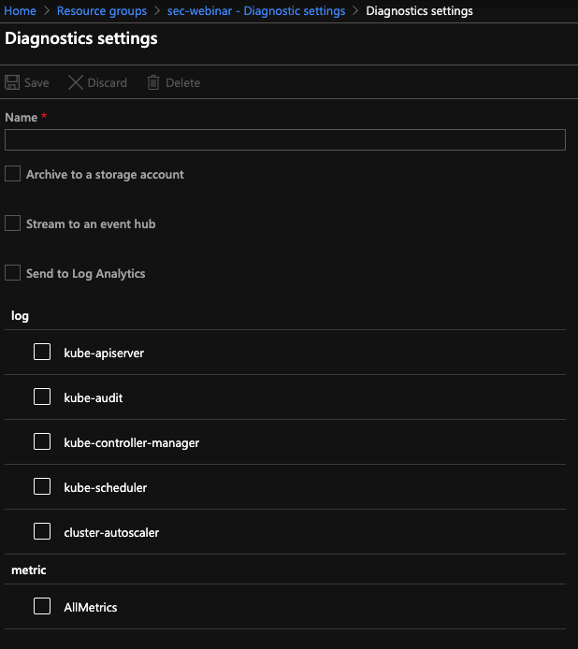
Enable Control plane logs (Audit Logs)
Use the Azure portal to enable diagnostics logs
Pipe logs to Log Analytics, Event Hub or a storage account
Metrics available today
kube-controller-manager
kube-api-server
kube-scheduler
Audit logs
cluster-autosclaer

Slide 16
Cluster Security
Dashboard Security

Slide 17
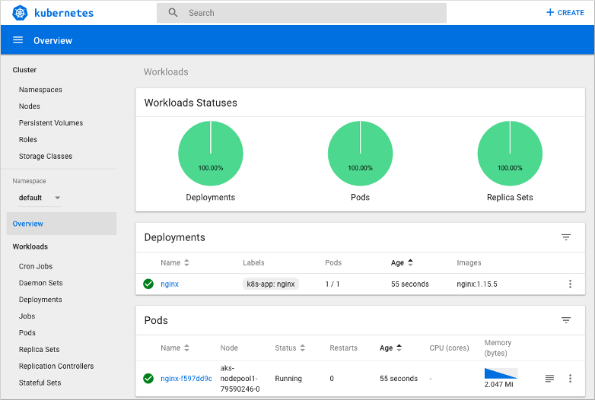
Kubernetes Dashboard

Slide 18
Disable the Dashboard (Recommended)
$ kubectl get pods -n kube-system | grep "dashboard"
kubernetes-dashboard-cc4cc9f58-whmhv 1/1 Running 0 30d
$ az aks disable-addons -a kube-dashboard -g k8s-demo -n k8s-demo-rbac
$ kubectl get pods -n kube-system | grep "dashboard"

Slide 19
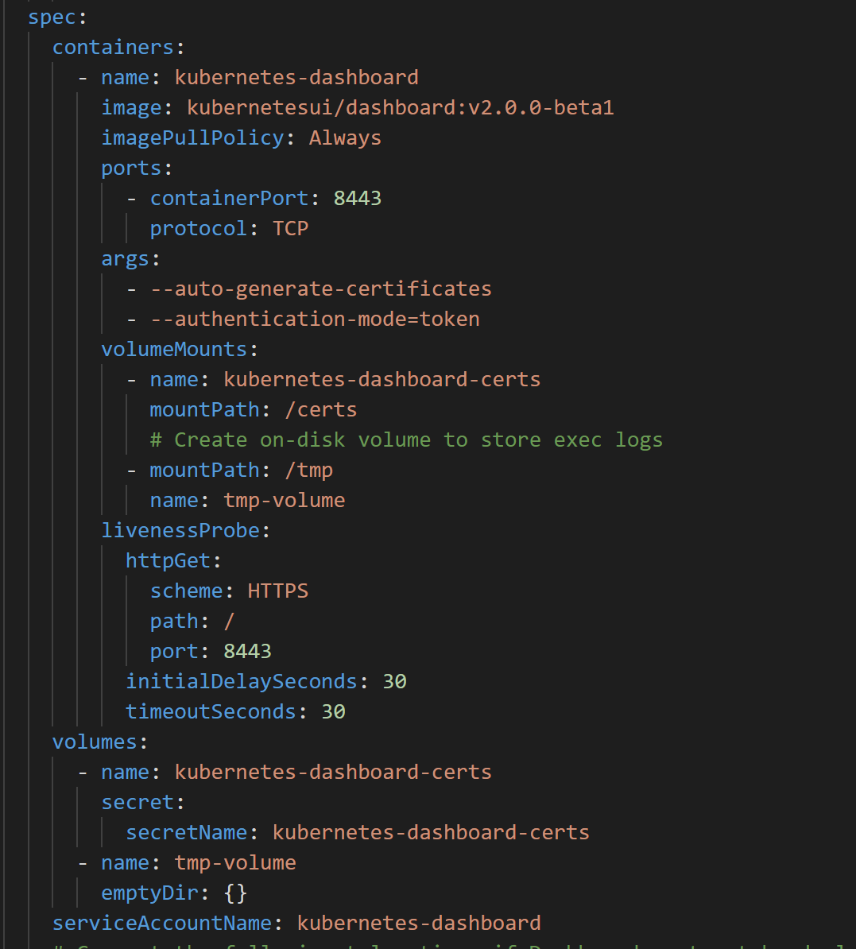
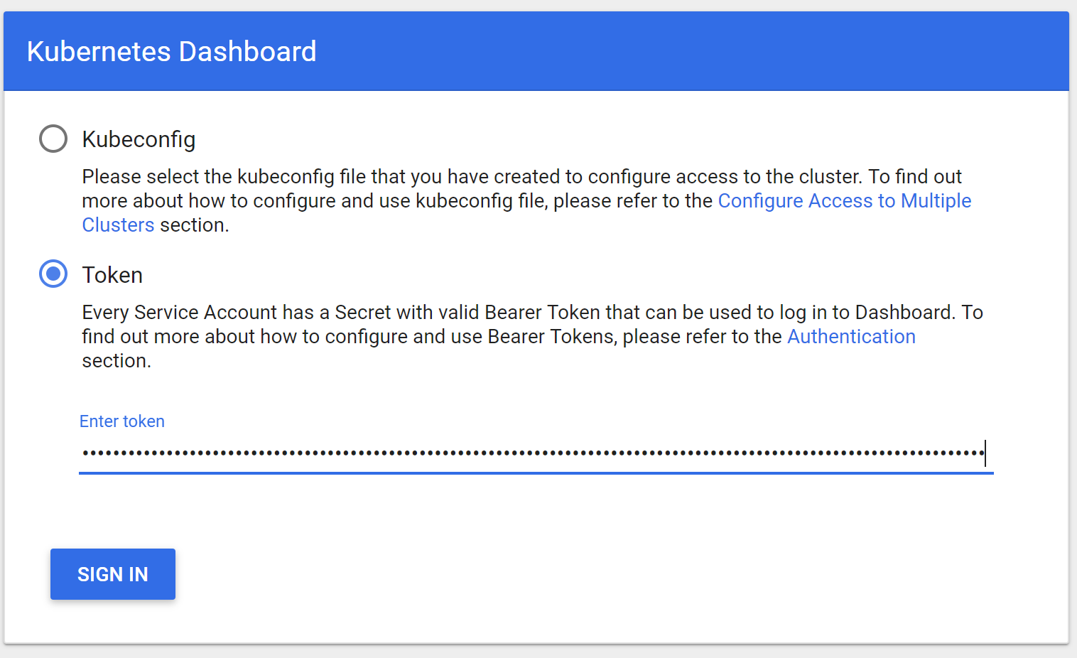
Kubernetes Dashboard – less worse

Slide 20
Cluster Security
Securing the API Server

Slide 21

API Server Authorized IP Ranges
Kubernetes cluster
Lock down the Kubernetes API server to a set of trusted endpoints (IP CIDRS)

Slide 22
Cluster Security
Securing Egress Traffic

Slide 23
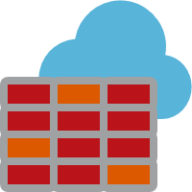
North/South Traffic in AKS with Azure Firewall
Target FQDN
*.azmk8s.io (Eg. *eastus.azmk8s.io) – API Server
aksrepos.azurecr.io – Microsoft Images
*mcr.microsoft.com – Microsoft Images
*security.ubuntu.com – Ubuntu Security Updates
login.microsoftonline.com - AAD
management.azure.com – Azure API
L3-L7 Connectivity Policies
AKS Subnet
NAT, Network and Application traffic filtering rules allows Inbound/Outbound access
Firewall Subnet
AKS Subnet
Azure Firewall
NAT Rules
TCP Port 9000, 22 and 443 for API server FQDN and IP Address TCP port 443 for the above FQDNs
AKS Clusters
Azure to On-Prem traffic filtering
Traffic is denied by default
On-Premises

Slide 24
Cluster Security
Securing Ingress Traffic

Slide 25
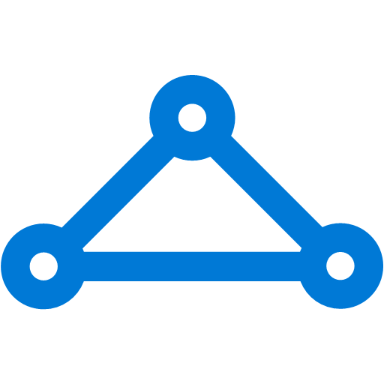



Ingress
On-premises infrastructure
Enterprise system
kind: Ingress
metadata:
name: contoso-ingress
annotations: kubernetes.io/ingress.class: ”PublicIngress"
spec:
tls:
- hosts:
- contoso.com
secretName: contoso-secret
rules:
- host: contoso.com
http:
paths:
- path: /a
backend:
serviceName: servicea
servicePort: 80
- path: /b
backend:
serviceName: serviceb
servicePort: 80
Azure Express Route
Azure AKS VNet
Private IP
Public IP
Public LB
Internal LB
AKS subnet
AKS cluster
PublicIngress
PrivateIngress
contoso.com/A
contoso.com/B
serviceC.contoso.com
ServiceA
ServiceB
ServiceC

Slide 26

Securing Kubernetes Services with WAF
Azure Management VNET
APP GW Subnet
Azure AKS VNet
VNet peering
Private IP
AKS subnet
Internal LB
AKS cluster
Ingress
contoso.com/A
contoso.com/B
service.contoso.com
ServiceA
ServiceB
ServiceC

Slide 27
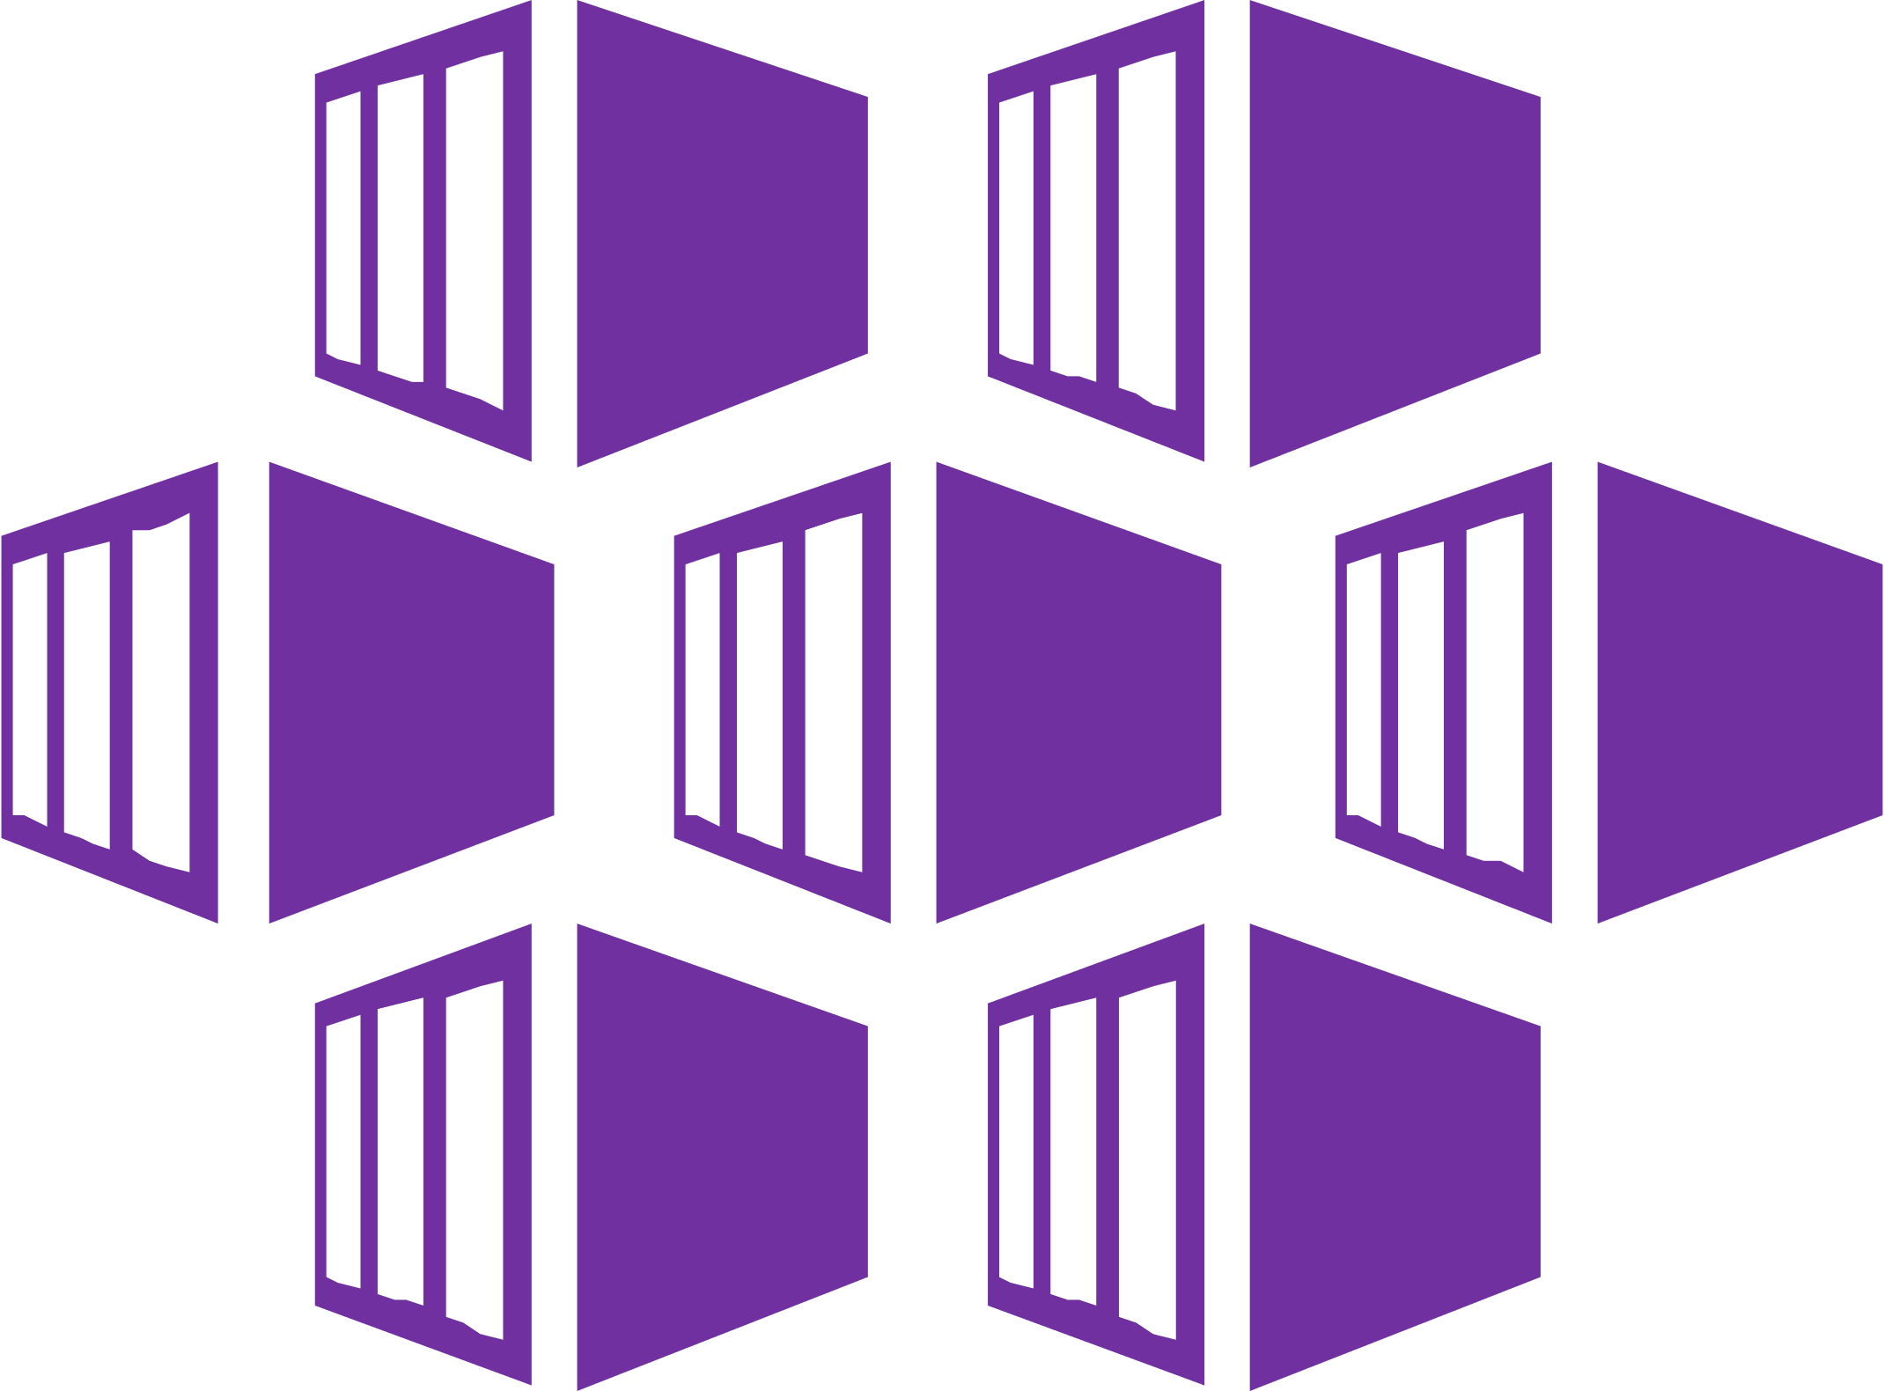


Application Gateway Ingress Controller
Attach Application Gateways to AKS Clusters
Load Balance from the Internet to pods
Supports features of k8s ingress resource – TLS, multi-site and path-based routing
Pod-AAD for ARM authentication
https://github.com/Azure/application-gateway-kubernetes-ingress
Azure Kubernetes Service (AKS)
Application Gateway
API server
Ingress Resource
Application Gateway Ingress Controller
Application Gateway Routing Rules
Azure ARM

Slide 28
AKS Defaults
Operating system security patches are automatically pushed to your nodes on a nightly schedule
AKS uses a security hardened operating system image which complies to CIS benchmark https://docs.microsoft.com/en-us/azure/aks/security-hardened-vm-host-image
Nodes are deployed in a private network with private IPs
Azure Storage is encrypted at rest by default

Slide 29
Image Security

Slide 30

Image Security
Your private registry, with built-in Helm chart support, only deploys validated images and can be automatically geo-replicated to the data center close to where your users are
Developer
Azure Container Registry
Azure Kubernetes Service
Azure Pipelines
Aqua Security or Twistlock image scanning
Fail
Pass
Held in quarantine image invisible

Slide 31
Image Security
AKS & ACR integration with Azure Security Center

Slide 32


Image Scanning in Azure Security Center
Azure Container Registry support in Azure Security Center
Discovery of scanned Azure Container Registry (ACR) registries in a customer subscription within Azure Security Center (ASC)
Vulnerability scanning for all pushed images to ACR registries in a customer subscription
Visibility into security vulnerabilities: description, details and severity classification
Vulnerability scanning
ACR
ASC
Actionable recommendations
Variabilities details with severity classification for scanned images
AKS
Cluster
Cluster
Cluster
Public Preview Q4 CY19

Slide 34


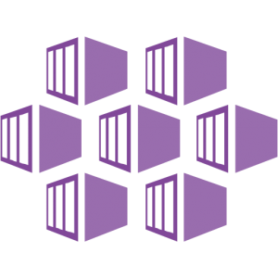

AKS Support in Azure Security Center
Continuous discovery of managed AKS instances within Azure Security Center
Actionable recommendations for best practices and threat remediation
Intelligent analytics for threat detection
Seamless native auto provisioning through Azure Security Center
Continuous discovery of managed AKS instances
Actionable recommendations for security best practices
Azure Security Center
Detect threats across AKS nodes and clusters using advanced analytics
Azure Container Registry
Azure Kubernetes Service
Public Preview Q4 CY19

Slide 36
Securing
Workloads/Containers

Slide 37
Securing East/West traffic
Network segmentation

Slide 38
Kubernetes cluster
Kubernetes Network Policy
Control network traffic within the cluster
Restrict pod⬄ pod communication in a cluster
Choice of plugins: Azure-native or OSS Calico project

Slide 39
When to use Azure NSG/FW vs. Kubernetes Network policy
Azure Network Security Groups and FW
Use it to filter North-South traffic, that is, traffic entering and leaving your cluster subnet
Kubernetes Network Policies
Use it to filter East-West traffic, that is, traffic between pods in your cluster

Slide 40

Pod Identity
Pod identity
Securely communicate with a variety of Azure services, like Key Vault and Storage
Give Kubernetes pods their own first-class identity in Azure Active Directory
No additional keys or secrets to manage https://github.com/Azure/aad-pod-identity
GA Upstream
*Coming to AKS as managed plugin soon
Project
Cluster
Node
Namespace
Pod
Containers
Validate requests with policies
Secure communication between Pods and other Azure services
Azure Key Vault
Azure Storage
Microsoft Confidential
Notes:
More information on pod security policy: https://azure.microsoft.com/en-us/updates/aks-pod-security-policy/
More information on pod identity: https://azure.microsoft.com/en-us/updates/aks-pod-identity/

Slide 41
Azure Key Vault Integration for Secrets
Key Vault Flex Volume driver for Kubernetes
Meet rigorous compliance requirements with secrets centrally stored outside of clusters​
Access application-specific keys, secrets, and certificates natively within Kubernetes from Azure Key Vault
Mount Azure Key Vault stores via flexvolume driver
https://github.com/Azure/kubernetes-keyvault-flexvol
CSI driver support is coming in Q1-20
GA Upstream
Coming to AKS as managed plugin soon​
Key Management System
Keys
Secrets
Certs
AKS
Pods
Key Management System
Keys
Secrets
Certs
Volume
Key Management System
Keys
Secrets
Certs
Microsoft Confidential
Notes:
More information: https://github.com/Azure/kubernetes-keyvault-flexvol

Slide 42
Pod Level – Pod Security Context
apiVersion: v1 kind: Pod metadata: name: security-context-demo spec: securityContext: runAsUser: 1000 fsGroup: 2000 volumes: - name: sec-ctx-vol emptyDir: {} containers: - name: sec-ctx-demo image: ignite.azurecr.io/nginx-demo volumeMounts: - name: sec-ctx-vol mountPath: /data/demo securityContext: runAsUser: 2000 allowPrivilegeEscalation: false capabilities: add: ["NET_ADMIN", "SYS_TIME"] seLinuxOptions: level: "s0:c123,c456"

Slide 43
Pod Security Policies [Preview]
Pod Security Policies (or PSPs) are objects that control security-sensitive aspects of pod specification (like root privileges)
If a pod does not meet the conditions specified in the PSP, Kubernetes will not allow it to start
You can assign PSPs at the cluster or project level
PSPs work through inheritance
Workloads that are already running in a cluster or project before a PSP is assigned will not be checked
Still BETA upstream!

Slide 44
Pod Security Policies
apiVersion: policy/v1beta1 kind: PodSecurityPolicy metadata: name: restricted annotations: seccomp.security.alpha.kubernetes.io/allowedProfileNames: 'docker/default’ apparmor.security.beta.kubernetes.io/allowedProfileNames: 'runtime/default’ seccomp.security.alpha.kubernetes.io/defaultProfileName: 'docker/default’ apparmor.security.beta.kubernetes.io/defaultProfileName: 'runtime/default’ spec: privileged: false allowPrivilegeEscalation: false # Required to prevent escalations to root. requiredDropCapabilities: # This is redundant with non-root + disallow privilege escalation, but we can provide it for defense in depth. - ALL volumes: # Allow core volume types. - 'configMap’ - 'emptyDir’ - 'projected’ - 'secret’ - 'downwardAPI’ - 'persistentVolumeClaim’ # Assume that persistentVolumes set up by the cluster admin are safe to use. hostNetwork: false hostIPC: false hostPID: false runAsUser: rule: 'MustRunAsNonRoot’ # Require the container to run without root privileges. seLinux: rule: 'RunAsAny’ # This policy assumes the nodes are using AppArmor rather than SELinux. supplementalGroups: rule: 'MustRunAs’ ranges: - min: 1 # Forbid adding the root group. max: 65535 fsGroup: rule: 'MustRunAs’ ranges: - min: 1 # Forbid adding the root group. max: 65535 readOnlyRootFilesystem: false

Slide 45
Azure Policy for Kubernetes
Dynamically enforce guardrails defined in Azure Policy across multiple clusters—nodes, pods, and even container images can be tracked and validated at the time of deployment or as part of CI/CD workflows
Cloud Architect
Azure Policy
Compliance reports
Assigns a policy across clusters
Cluster-1
Cluster-2
Cluster-3
Compliance reports for the entire environment, with pod-level granularity
Real-time enforcement of policy and feedback
AKS
Developer
Cluster-1
Cluster-2
Cluster-3

Slide 46
Summary

Slide 47
App Before
AKS subnet
Azure Files
Web Pod(s)
Worker Pod(s)
External
Load Balancer

Slide 48
App After
Secure Registry
via Service Endpoints
Reduce Secrets Mgmt
via AAD Pod Identity
API server
Azure Container Registry
Secure access to the API Server with API whitelisting and AAD
Azure Firewall Subnet
App Gateway Subnet
AKS subnet
Web Pod(s)
Worker Pod(s)
Azure Files
Service Endpoint
Internal Load Balancer
Secure File Share Access
via Service Endpoints
Control Outbound Traffic
via Azure Firewall
Adding WAF & Ingress
via App Gateway
No Public IP via
Internal LB
Network Segmentation
via Network Policy

Slide 49
Demo
Put it all together!

Slide 50
Resources
Demos, slides and transcript for this webinar can be found here
https://github.com/mohmdnofal/aks-best-practices
Recommended book
“Kubernetes Security” by Liz Rice, and Michael Hausenblas
Interested in learning more about tenancy and scheduling?
https://aka.ms/AA6jf7r
AKS best practices
https://docs.microsoft.com/en-us/azure/aks/best-practices

Slide 51






Best support for your enterprise need
Learning path aka.ms/LearnKubernetes
What is Kubernetes aka.ms/k8sLearning
Hear from experts aka.ms/AKS/videos
Case studies aka.ms/aks/casestudy
Azure Kubernetes Service aka.ms/AKS/page
Try for free aka.ms/aks/trial

Slide 52
Q&A

Slide 53
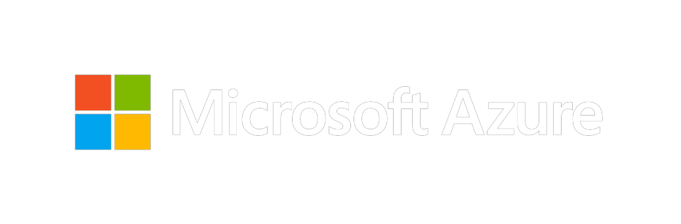
Thank you for joining us.
© 2018 Microsoft Corporation. All rights reserved. Microsoft, Windows, Windows Vista and other product names are or may be registered trademarks and/or trademarks in the U.S. and/or other countries.
The information herein is for informational purposes only and represents the current view of Microsoft Corporation as of the date of this presentation. Because Microsoft must respond to changing market conditions, it should not be interpreted to be a commitment on the part of Microsoft, and Microsoft cannot guarantee the accuracy of any information provided after the date of this presentation. MICROSOFT MAKES NO WARRANTIES, EXPRESS, IMPLIED OR STATUTORY, AS TO THE INFORMATION IN THIS PRESENTATION.

